Slide 1
Final Presentation
Victor Adekola & Nana Prempeh

Slide 2
Introduction
This presentation will cover all the contents we did in Ctec 128 and Ctec 298 also the materials we submitted.

Slide 3
Summaries of ctec 128 papers
Group leader
Member 1
● Understanding the difference of trends between people buying/renting a house
● Providing the reader with data on the demographics of who owns/rents a house
● Finding out average income for homeowners and renters.
Covering how stereotypes affect black students and how they are more prone to get into school trouble than other demographics.
Highlighting the racial inequalities in teacher-issued office punishment referrals are less well-documented than the suspension gaps. Referrals for discipline, such as suspension, might result in lost instructional time.

Slide 4
Description of ctec materials
Group Leader
An Excel spreadsheet was used to arrange and tidy the data for this table.
The spreadsheet's redundant data types were eliminated to make it simpler to edit and create graphs.
When using Jupyter Notebook, we may import the matplotlib library.

Slide 5
Member 1
Description of ctec materials
In order to find out whether the stereotype that black students often get into school issues and disciplinary actions more than whites, to complete this data was used from the CRDC database using data from 2017-2018. Along with csv files downloaded from the crdc database

Slide 6
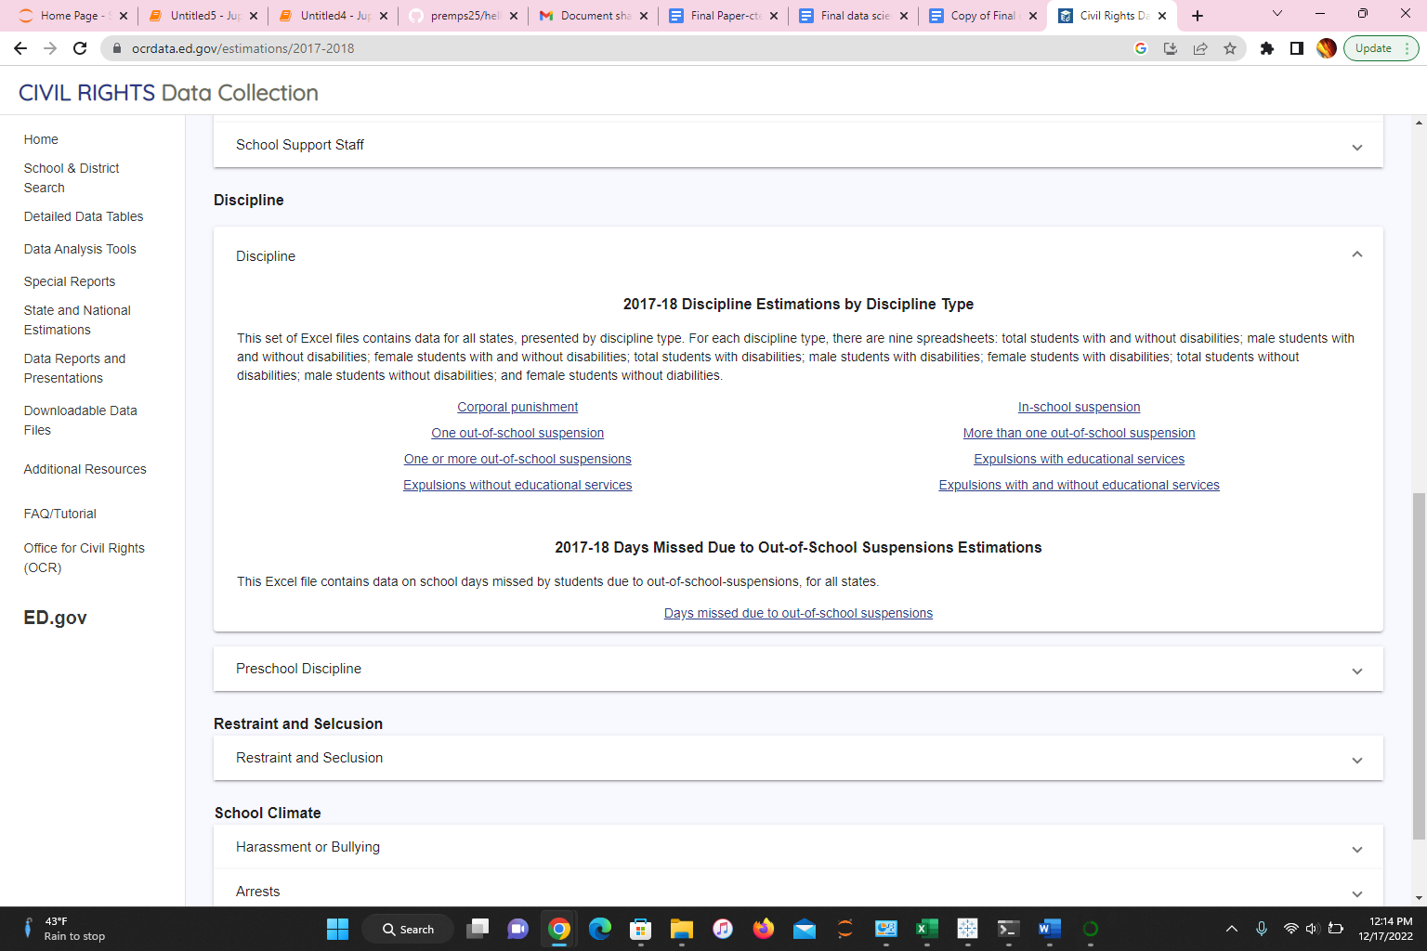
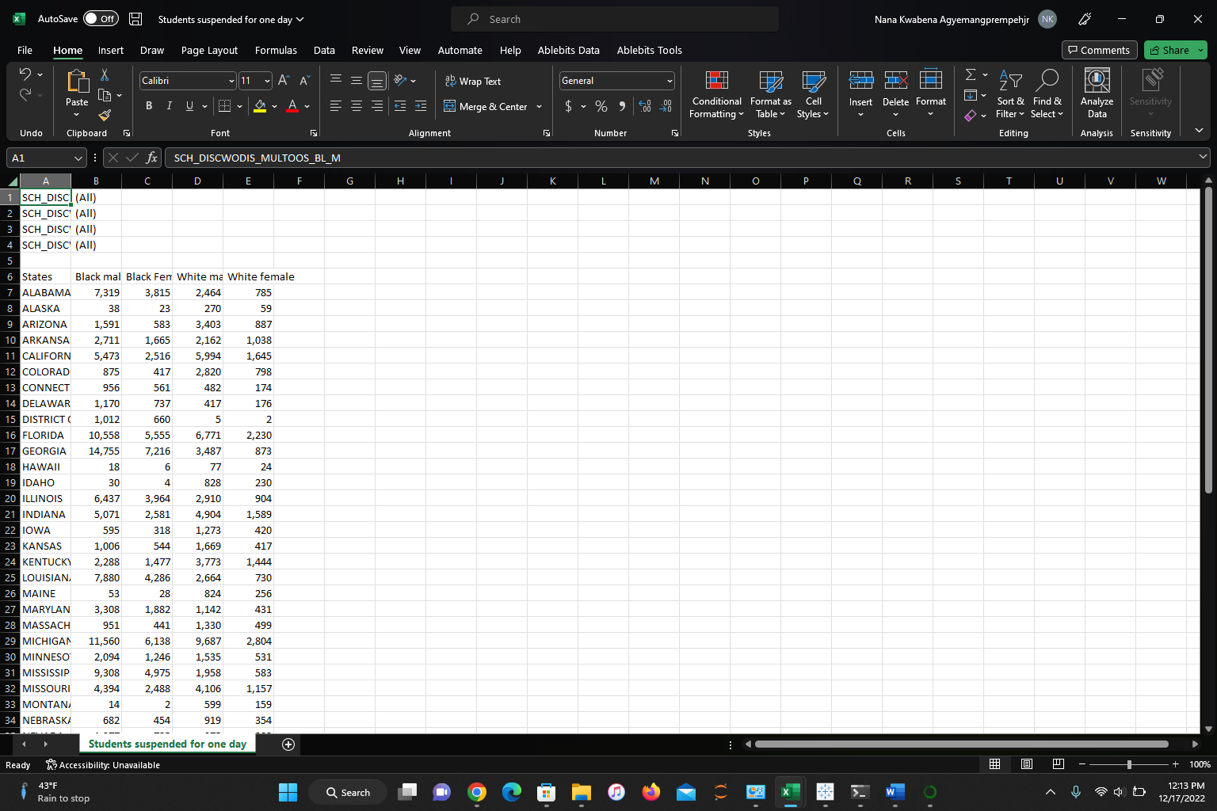

Slide 7
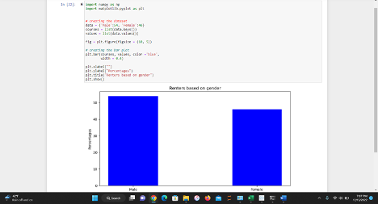
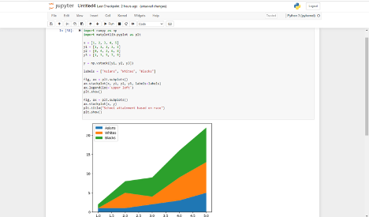
Description of Plot deliverables: Group leader
The movement toward homeowners and renting is also affected all levels of educational achievement.
There is a significant difference based on gender. The male gender seems to be more prevalent than the female gender in both homeownership and renting.

Slide 8
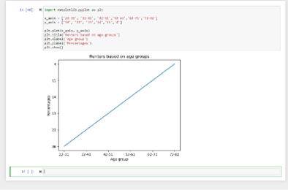
Description of plot deliverables: Member 1
About 36% of households preferred renting, and they are people who are between the ages of 22-31.
They are followed by individuals under the ages of 32 and 41 in renting housing units, especially when they stay. On the other hand, individuals owning houses stand at 23%
the majority of these people fall under the age bracket of 52-61.

Slide 9
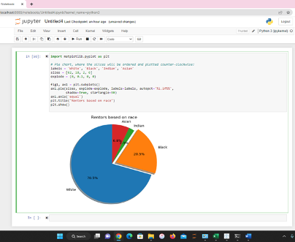
Black and Hispanic individuals have about twice as likely as white people to rent their housing units.
Whites lead in both homeowners and renters with 77% and 62%.
These statistics could be different and most important when major racial and ethnic groups can rent housing units.
Therefore, an increase in the rental rates will affect several families

Slide 10
Summary/Conclusion
The data visualizations can be used to build some conclusions about the data. After considering the data, it can be concluded that 60-70% were White and the rest of the categories making up that remaining 30%.
Overall, it would be safe to say there are more renters in the age group 22-31 as compared to the others and more homeowners in the age group 52-61
As compared to the rest of the age groups, more male homeowners and renters as compared to the opposite sex and also people who have attained a bachelor’s degree tend more to be homeowners and renters.Also based on this data and plots you can get a sense of how the data will be interpreted

Slide 11
References
Lewin, T. (2012). Black students face more discipline, data suggests. The New York Times.
Kinsler, J. (2011). Understanding the black–white school discipline gap. Economics of Education Review, 30(6), 1370-1383.
Blake, J. J., Smith, D. M., Marchbanks, M. P., Seibert, A. L., Wood, S. M., & Kim, E. S. (2016). Does student–teacher racial/ethnic match impact Black students’ discipline risk? A test of the cultural synchrony hypothesis. In Inequality in school discipline (pp. 79-98). Palgrave Macmillan, New York.
CRDC datasets
Bijlsma, M., &amp; Mocking, R. (2017). The impact of house price shocks on dutch homeowners
and renters (No. 346. RDF). CPB Netherlands Bureau for Economic Policy Analysis.
Brunner, E. J., Ross, S. L., &amp; Simonsen, B. K. (2015). Homeowners, renters, and the political
economy of property taxation. Regional Science and Urban Economics, 53, 38-49.
Diamond, R., Guren, A., &amp; Tan, R. (2020). The effect of foreclosures on homeowners,
tenants, and landlords (No. w27358). National Bureau of Economic Research.
Hankinson, M. (2018). When do renters behave like homeowners? High rent, price anxiety,
and NIMBYism. American Political Science Review, 112(3), 473-493.

